Slide 1
Hotel Sentiment Analysis
Mentor Name :
Karthik Muskula
Dhanyapriya Somasundaram
Group Members :
Avanti Kulkarni
Miss. Shreepradha Hegde
Mr. Giriganuru BhanuKiran
Meghanaveenkumarherimath
Mr. Rupesh Sarvade
Chanukya Kumar R
Mrs. Chilukoti Sowjanya

Slide 2
Business Objectives
Improve customer satisfaction: By analyzing the sentiment of hotel reviews, a hotel can identify areas where it is excelling and areas where it needs to improve. This can help the hotel to better understand the needs and expectations of its customers, and to make changes to its service or amenities to better meet those needs and improve customer satisfaction.
Monitor and respond to customer feedback: By regularly analyzing the sentiment of hotel reviews, a hotel can stay up-to-date on what its customers are saying about its service and amenities. This can help the hotel to quickly identify and respond to any issues or concerns that may arise, and to maintain a positive reputation with its customers.
3. Understanding Sentiment: To understand which elements of their hotel influence to form a positive review.

Slide 3
Project Architecture
EDA
Data
Importing
Deployment
Model Building
Model Evaluation

Slide 4
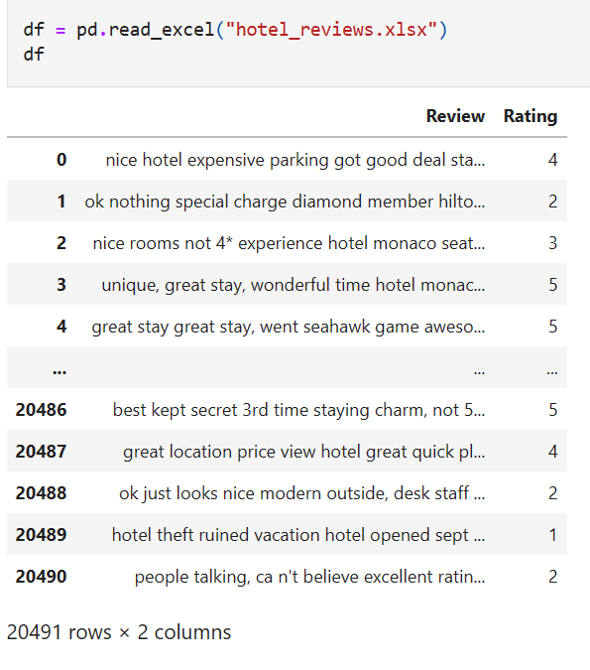
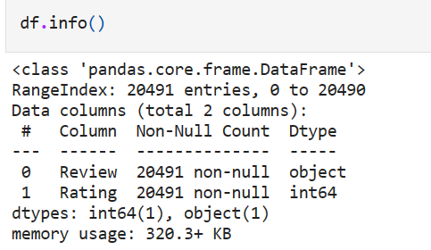
Importing Data
Data set contains 2 columns Review and Rating with 20491 rows.
Data contains no null and duplicates.
Rating column contains five unique values. i.e. from 1 to 5 numbers of ratings are present in the data set.

Slide 5
Exploratory Data Analysis
EDA
Plots
Data Pre-Process
Polarity
Word Cloud

Slide 6
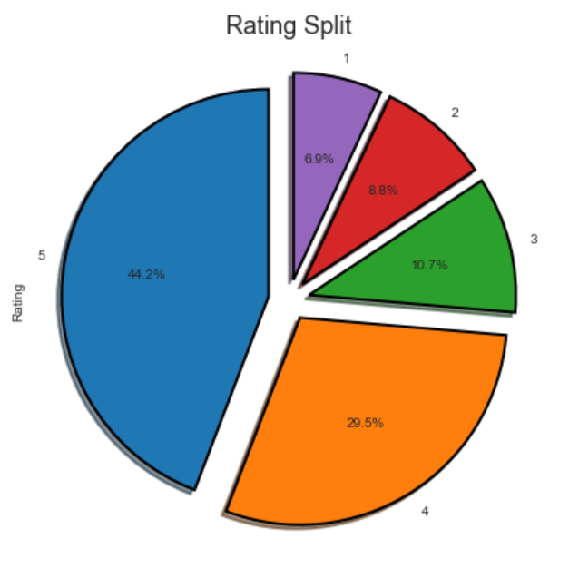
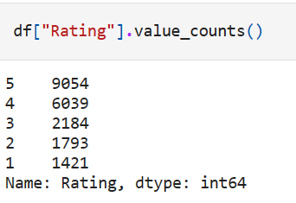
Plots
Total five types of ratings are present in the dataset.
Majority of 5 star ratings are present.
Minimum rating is 1.

Slide 7
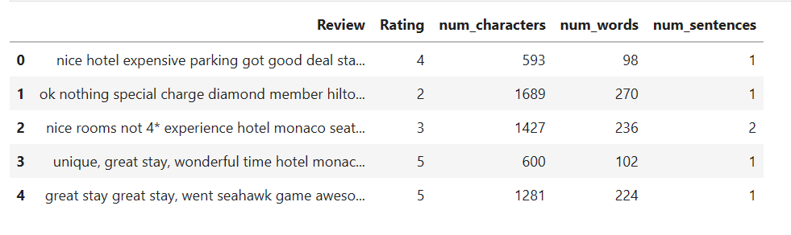
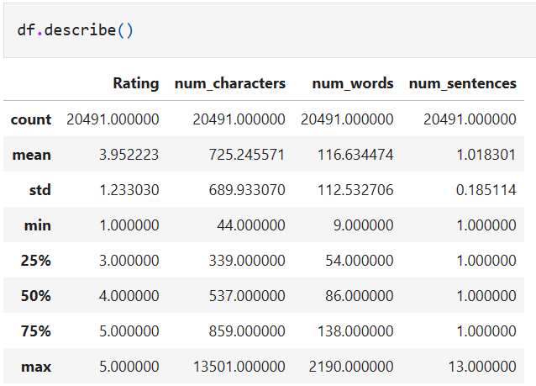
num_characters, num_words and num_sentences columns are created to check the impact of word on a sentence for each review/document.
Describe method gives the stats of a int columns.
Min number of sentence is 1 and max is 13.
As the number of characters increases the number of words are also increasing and vice versa.

Slide 8
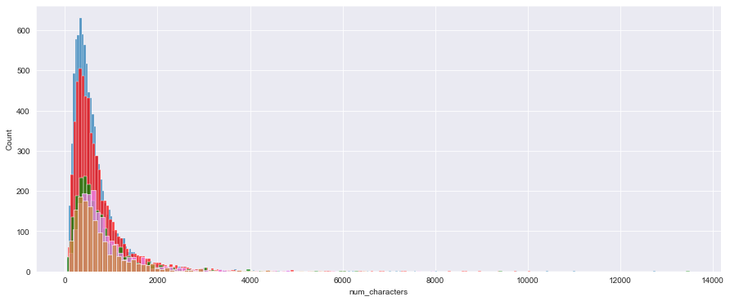
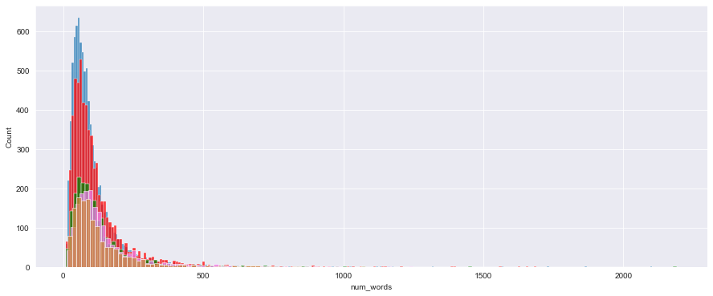

Slide 9
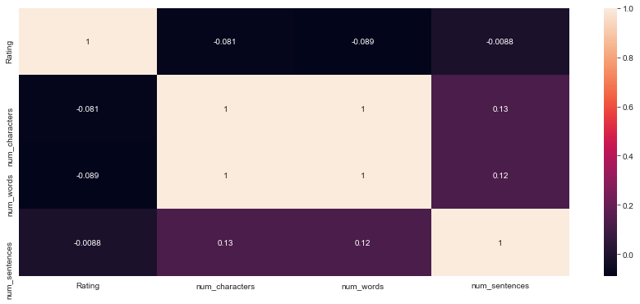
In the above Heatmap, the relationship between num characters and num words can be observed with the help of collinearity matrix.
Rating feature is negatively corelated with every other feature.

Slide 10
Data Pre-Process
Lower Case
Tokenization
Remove Special
Characters
Remove Stop-words Punctuations
Lemmatization
The purpose of lower casing, tokenization, removing stop-words and punctuations, and lemmatization is to preprocess text data so that it can be more easily and accurately analyzed by natural language processing (NLP) algorithms.
These processes can help to standardize the text data, reduce noise and complexity, and extract the most relevant and meaningful information from the text.

Slide 11
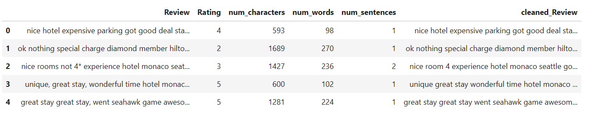
After Data Pre-Process

Slide 12
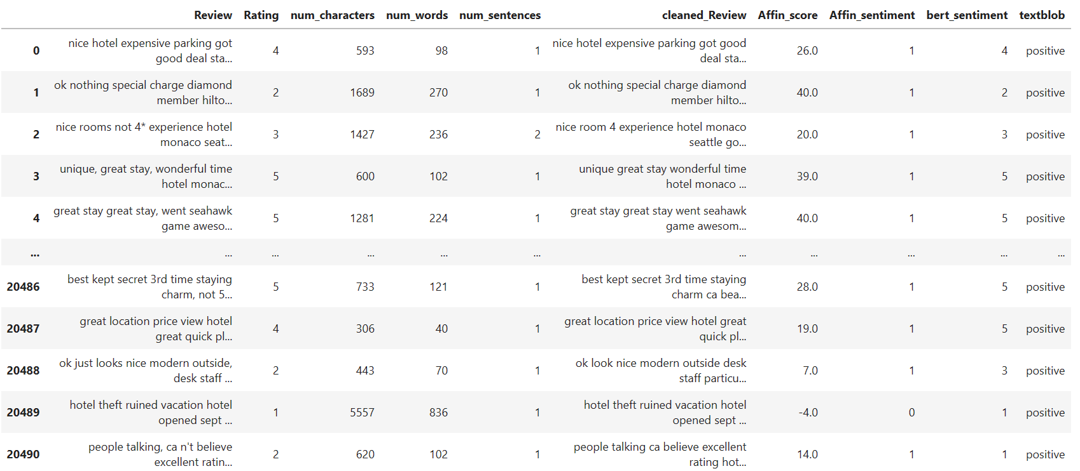
Polarity
To check the polarity of cleaned review feature, Afinn Sentiment, Bert Transformer and textblob are used for cross checking the output of each library.
Polarity is important for sentiment analysis because it refers to the direction or valence of the sentiment being expressed in a piece of text, and allows researchers and analysts to classify the overall sentiment as being positive, negative, or neutral, which can be useful for a variety of purposes, including identifying patterns and trends in customer sentiment and predicting the likelihood of certain outcomes or behaviors.

Slide 13
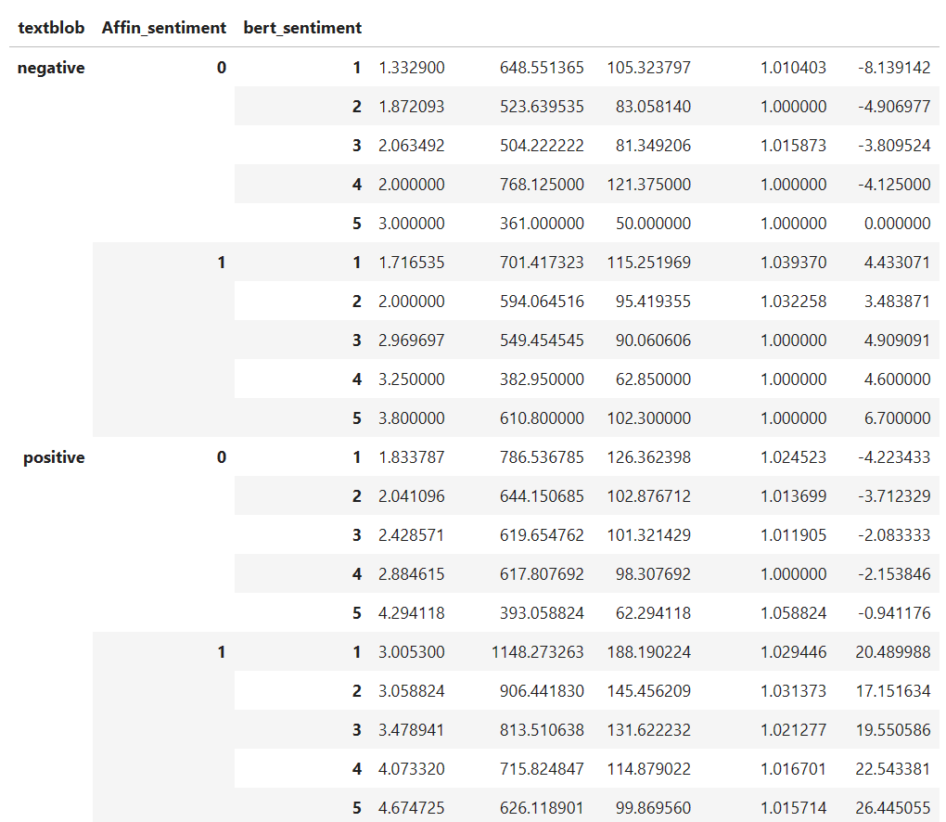
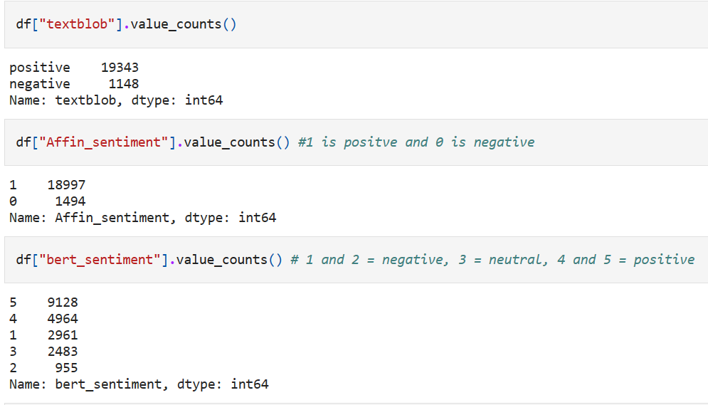
Mean of all Sentiment Libraries Output by grouping method.

Slide 14
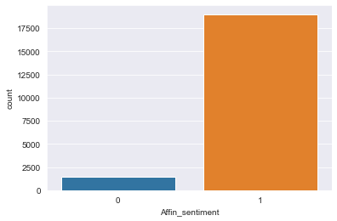
Here textblob and afinn sentiment are giving better results.
Since, only positive and negative sentiments in the problem statement for the classification, afinn sentiment will be used for further analysis.
By performing polarity, we conclude that the data is biased towards positive sentiments. Hence, the data is imbalanced.

Slide 15
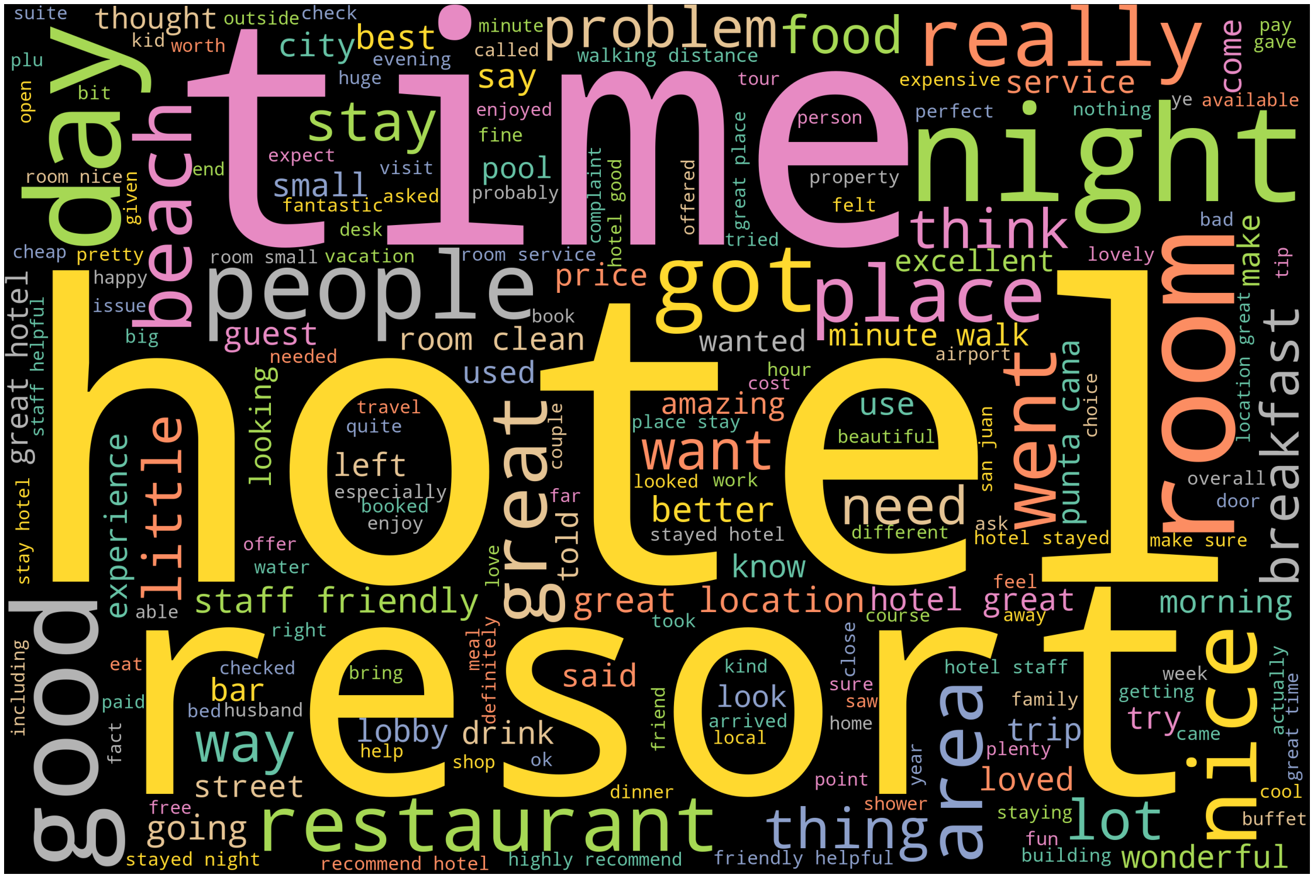
Word Cloud
Afinn Sentiment Positive

Slide 16
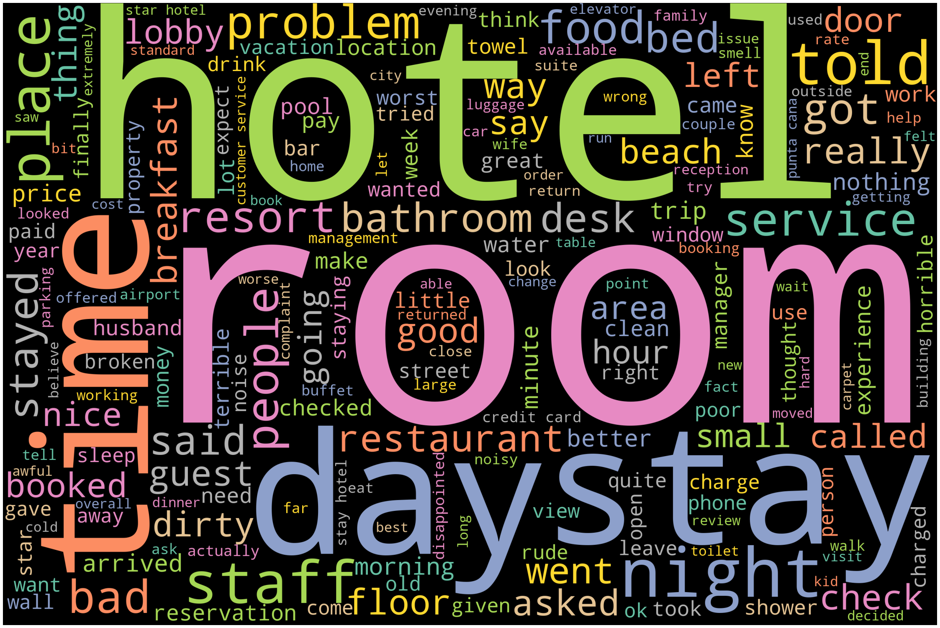
Word Cloud
Afinn Sentiment Negative

Slide 17
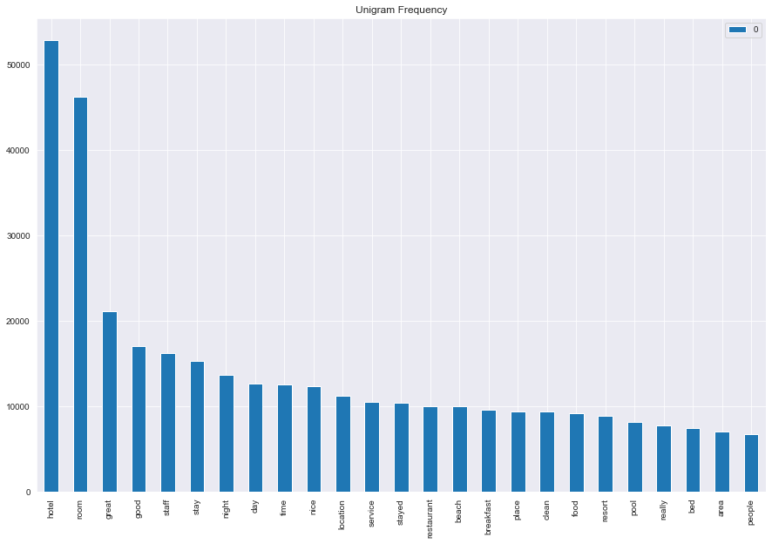
N-Grams Count-vectorizer

Slide 18
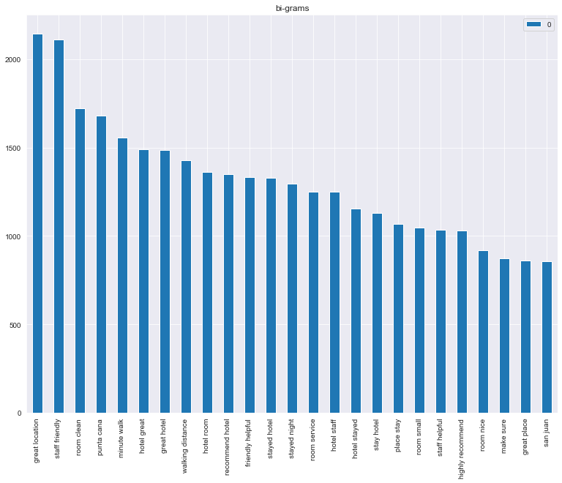

Slide 20
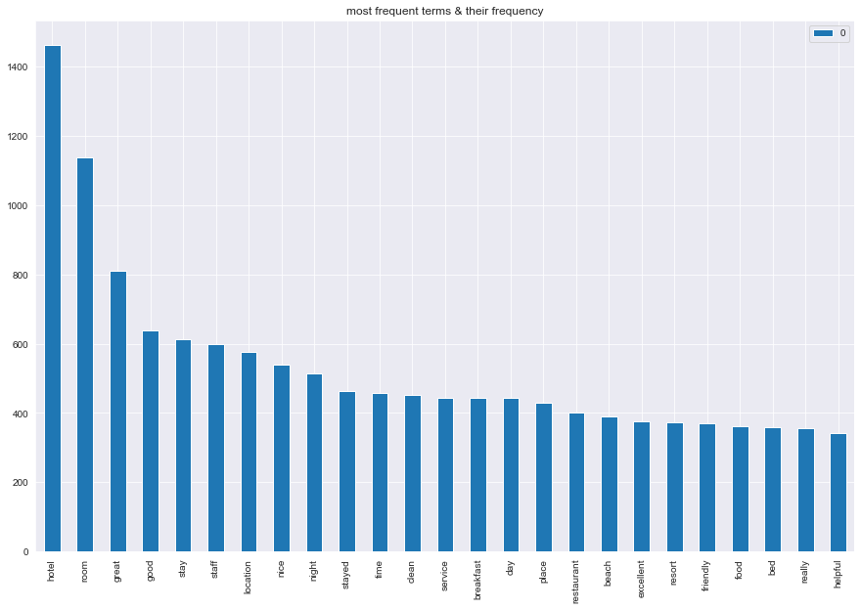
N-Grams TFIDF

Slide 21
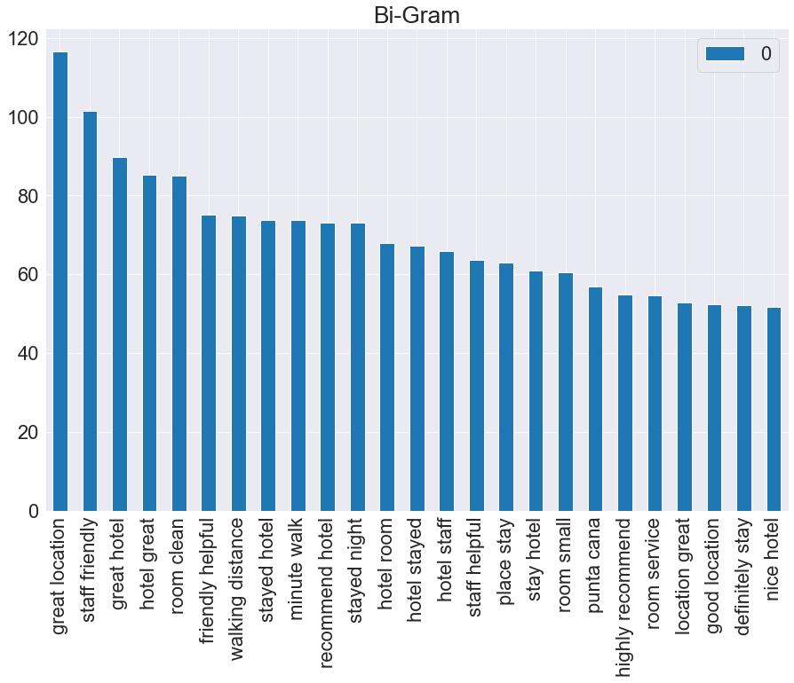

Slide 22
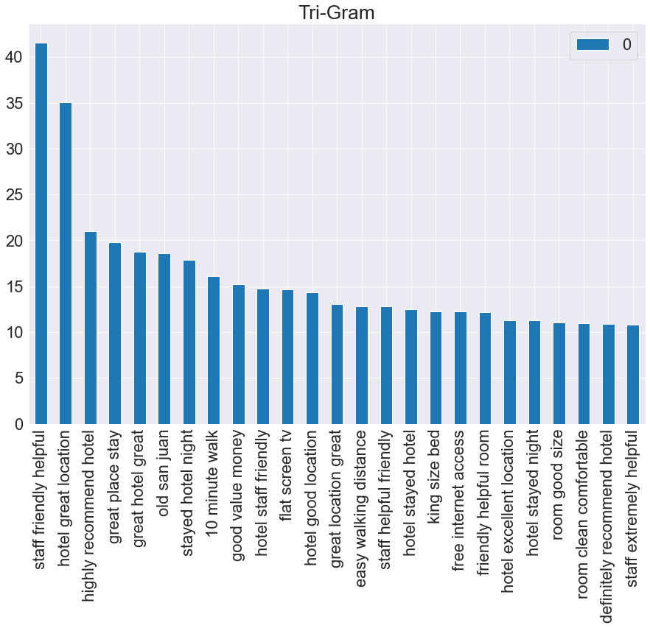

Slide 23
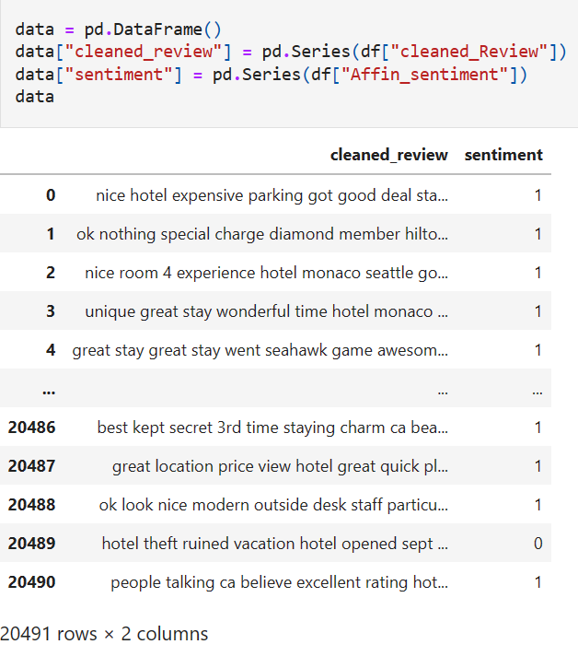
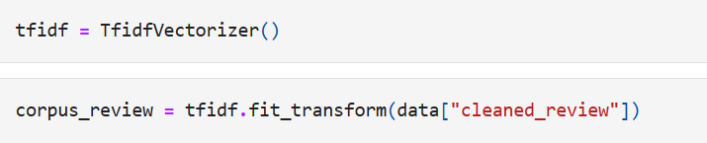
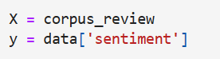
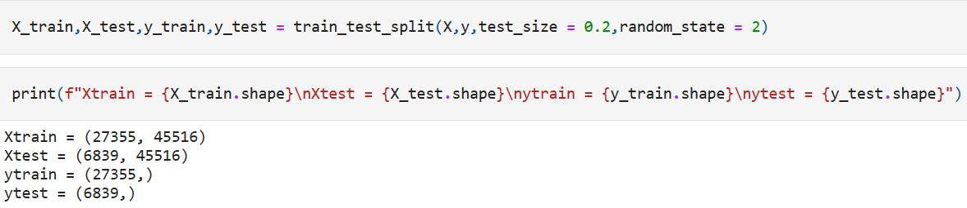
Model Building
To Create a Model Out of a provided dataset, preprocessed review columns and afinn sentiment column is selected.
TFIDF Vectorization Method will be used for model building.

Slide 24
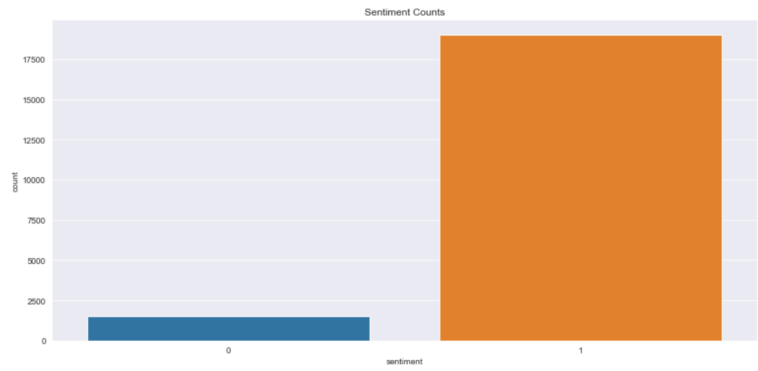
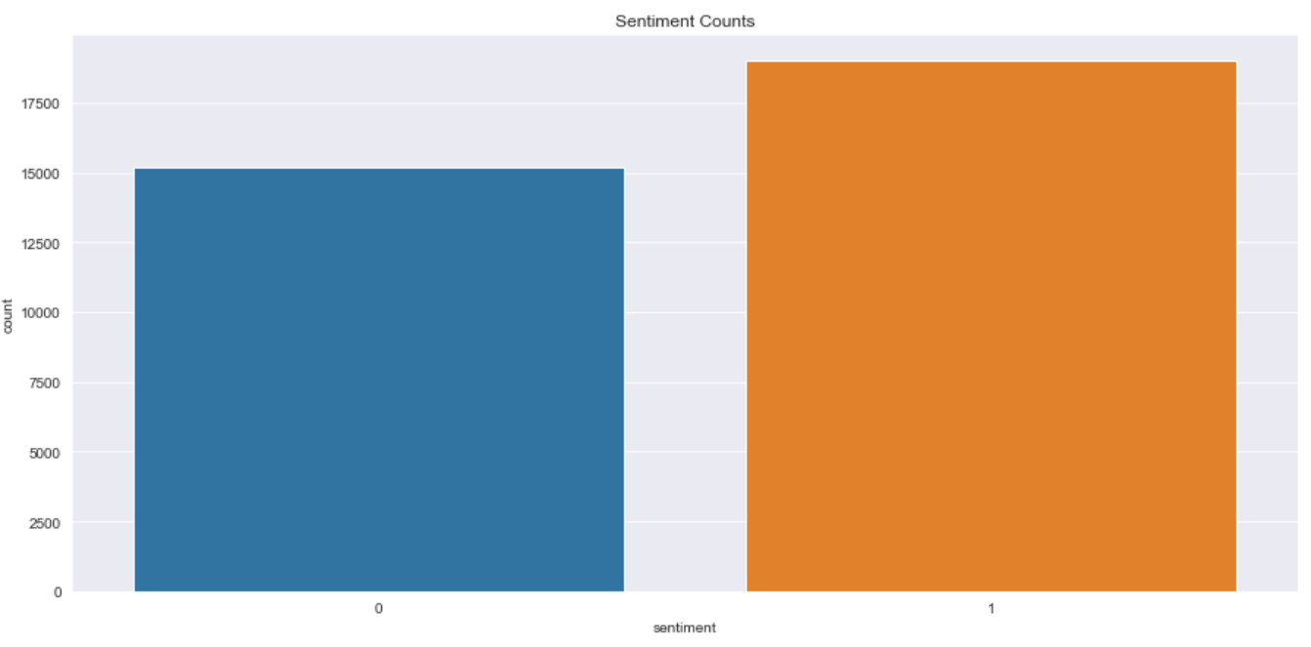
To balance the sentiment for better model performance SMOTE Oversampling method is used. Sampling strategy is set to 80%.
Before Sampling
After Sampling

Slide 25
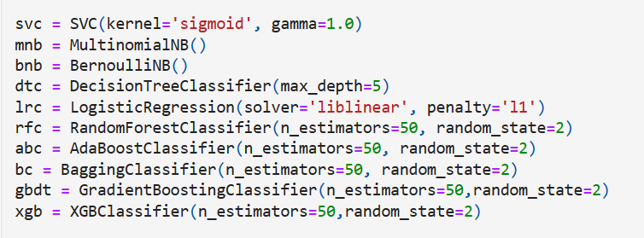
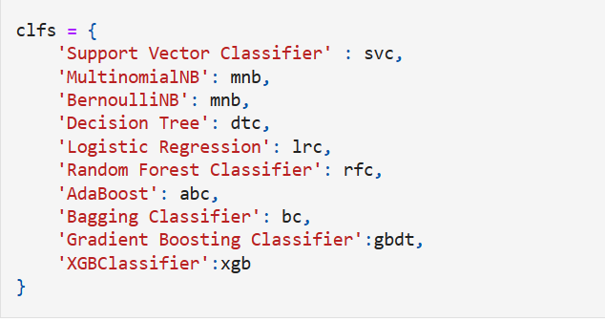
Algorithms
List of Algorithms Used for Model Building:
Support Vector Machine
MultinomialNB
BernoulliNB
Decision Tree
Logistic Regression
Random Forest Classifier
AdaBoost
Bagging Classifier
Gradient Boosting Classifier
XGBClassifier

Slide 26
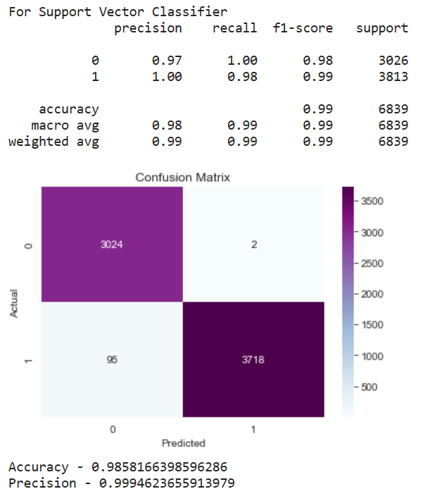

Model Evaluation
Support Vector Machine
MultinomialNB

Slide 27
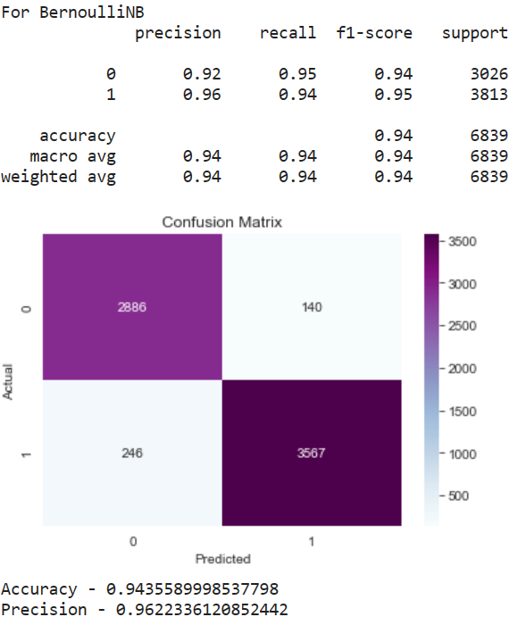
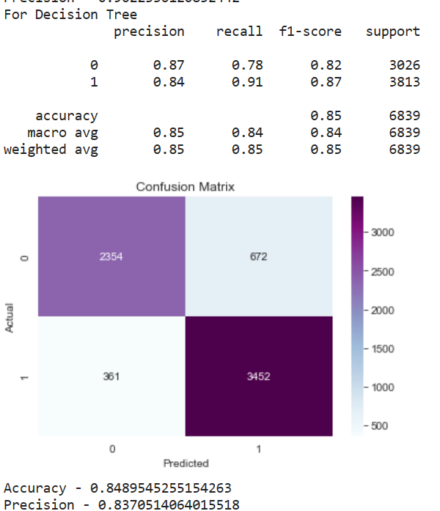
BernoulliNB
Decision Tree

Slide 28
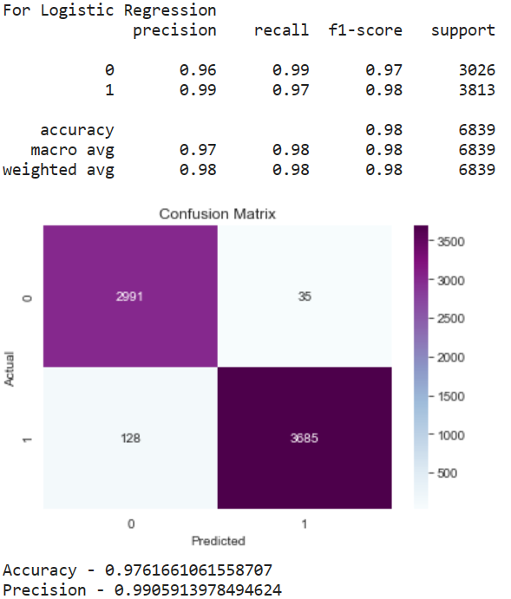
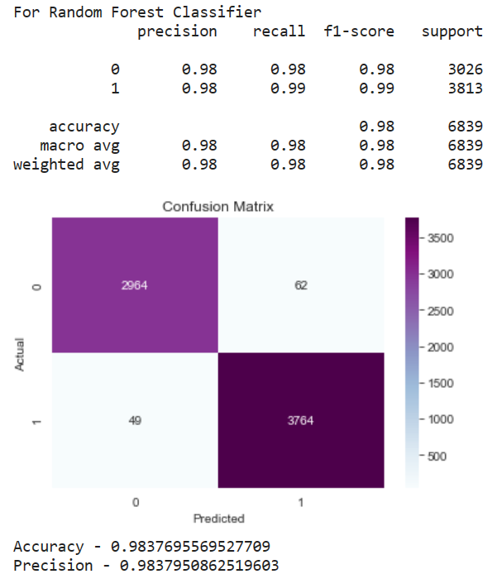
Logistic Regression
Random Forest Classifier

Slide 29

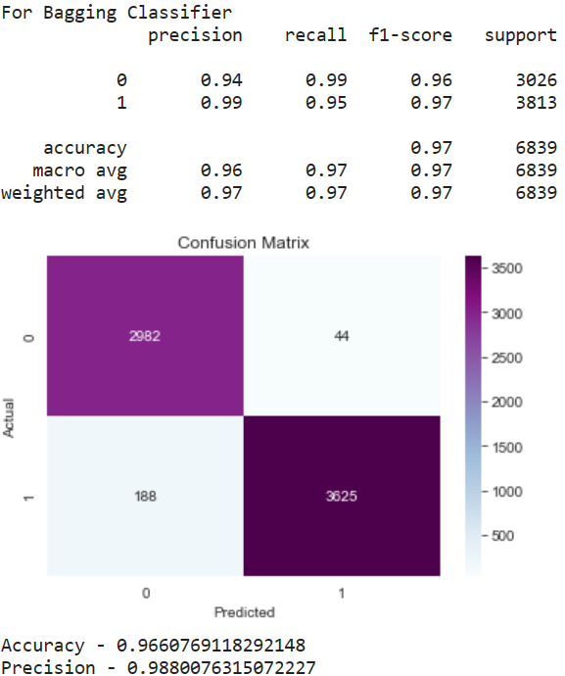
AdaBoost
Bagging Classifier

Slide 30


Gradient Boosting Classifier
XgbClassifier

Slide 31
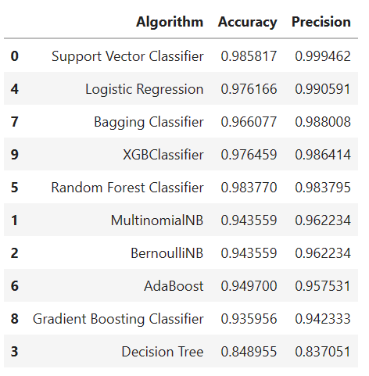

The Support Vector Classifier algorithm gives the good accuracy and precision score for the test data.
For the further Process Support Vector Classifier model with TFIDF vectorization will be used.

Slide 32
Model Deployment
Flask framework is used to create a sentiment analysis app.
By giving the review as an input the flask app shows following results.
Sentiment of statement
Sentiment Score
Important Keywords from input

Slide 33
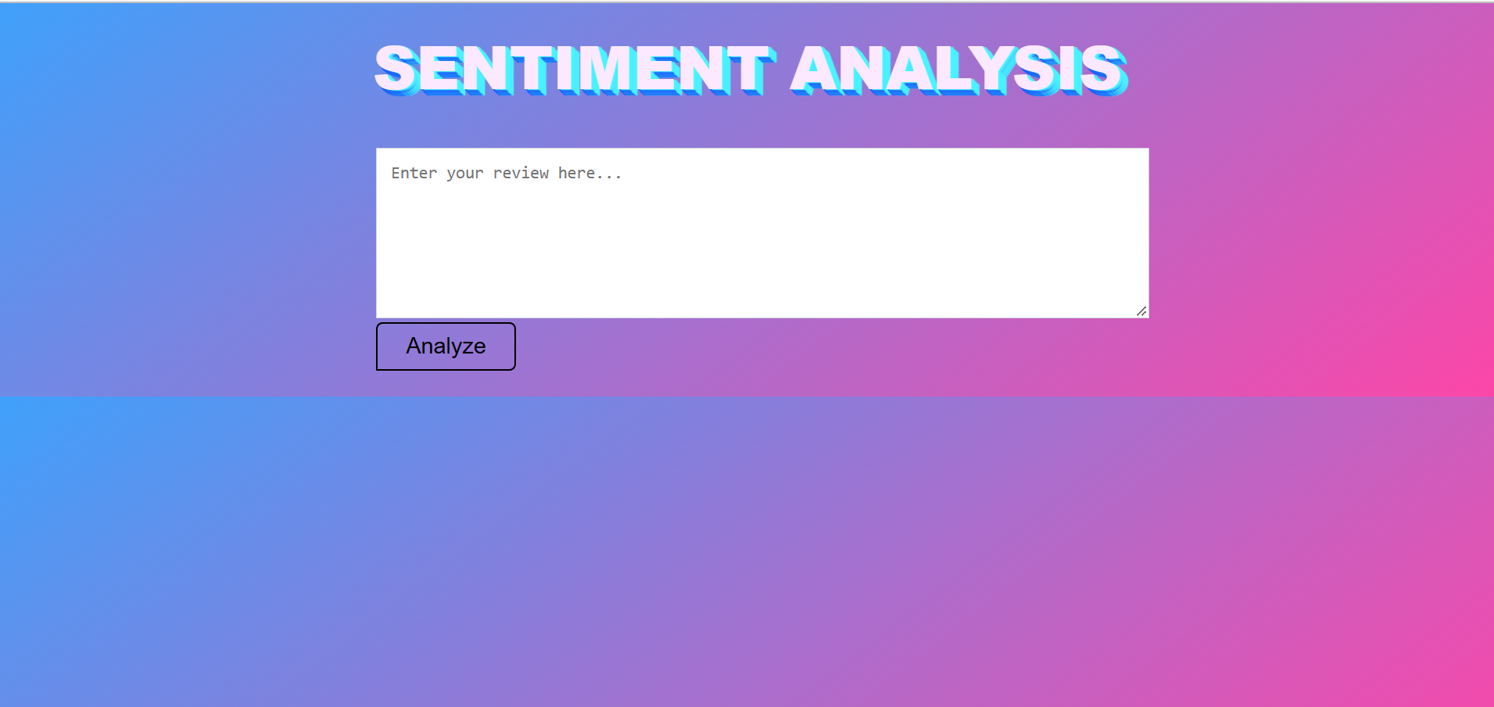
Model UI

Slide 34
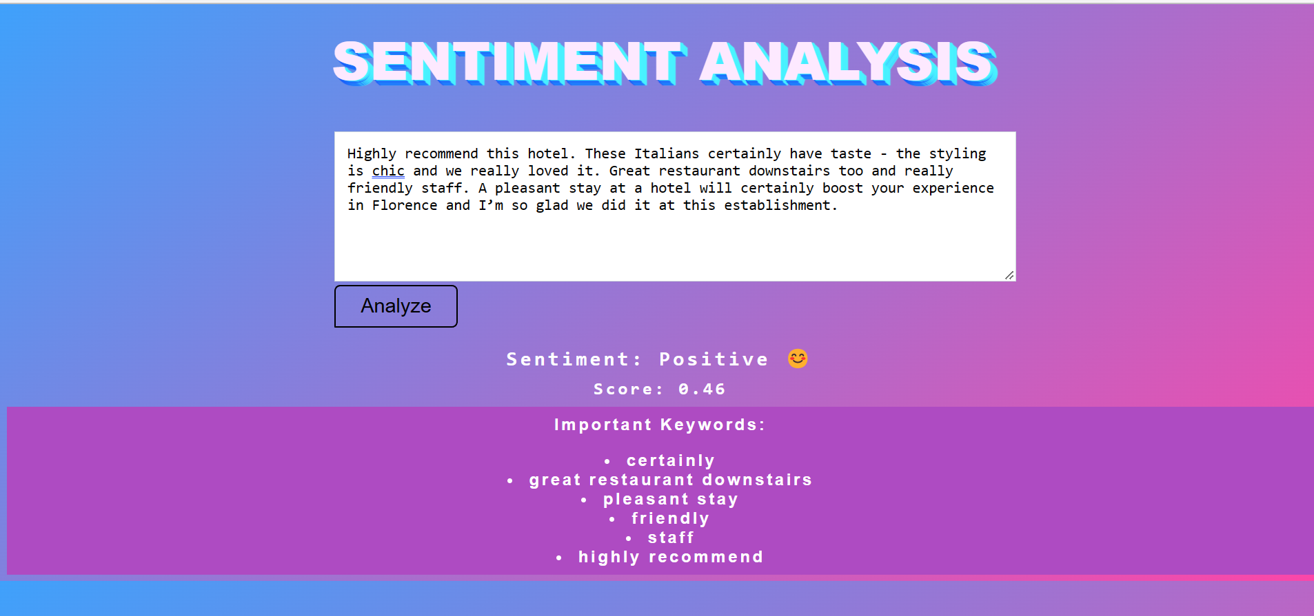
Results

